Slide 1
2U4G_C621WS PCIE SOP

Slide 2
A. Update 2U4G_SWB retimer FW

Slide 3
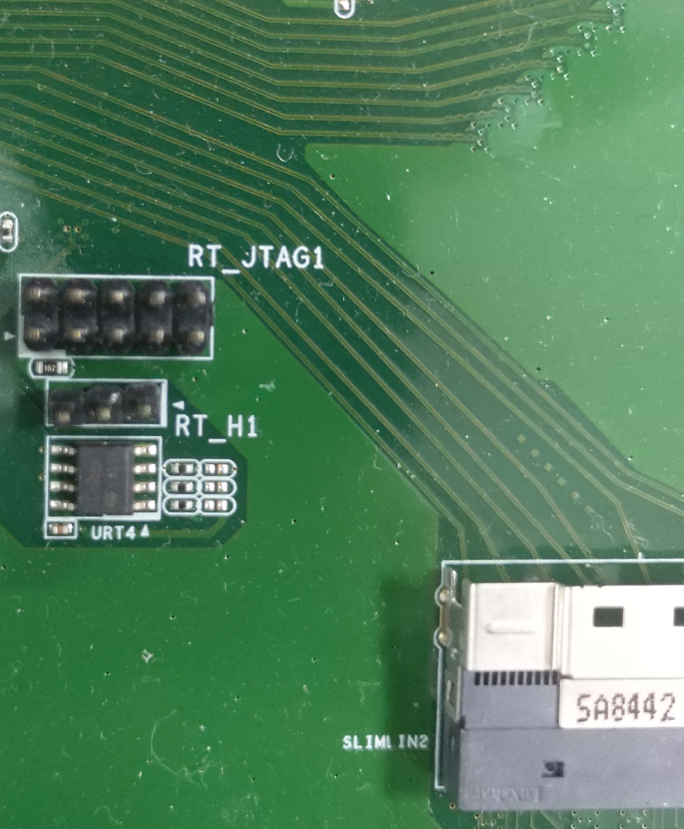
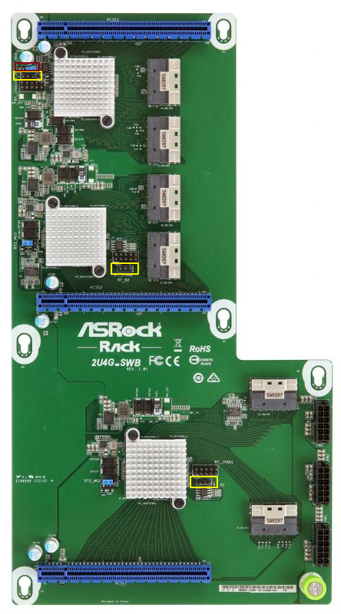
A-1 Power on the system and enter to BIOS A-2 Program retimer1 FW: Connect fixture to RT_H1 header

Slide 4
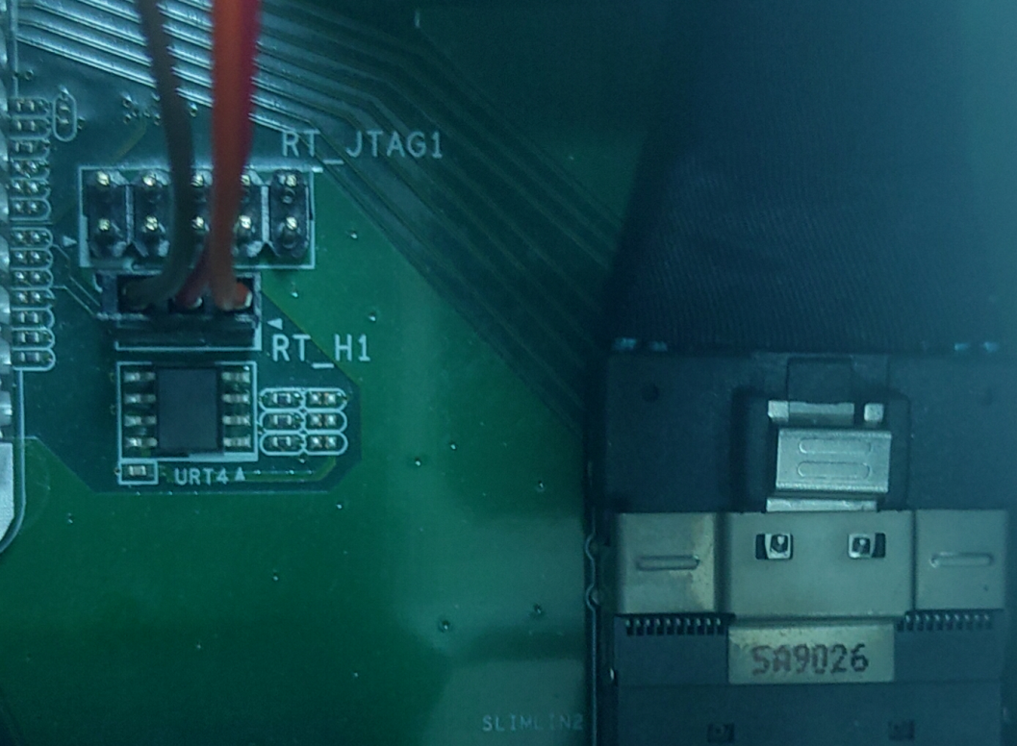
Orange cable to Pin 1

Slide 5
A-3 Execute retimer tool in client windows

Slide 6
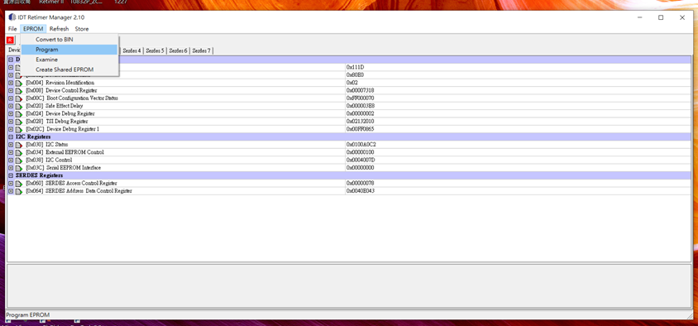
A-4 Select EPROM->Program

Slide 7
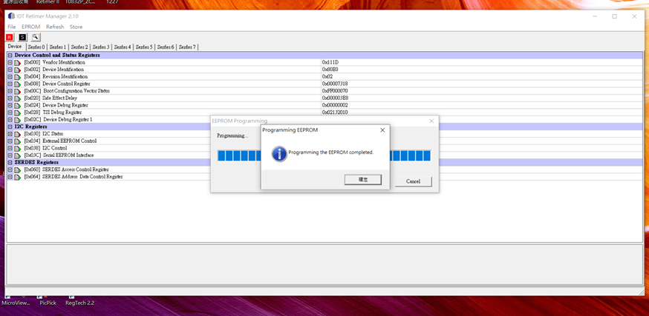
A-5 Programming

Slide 8
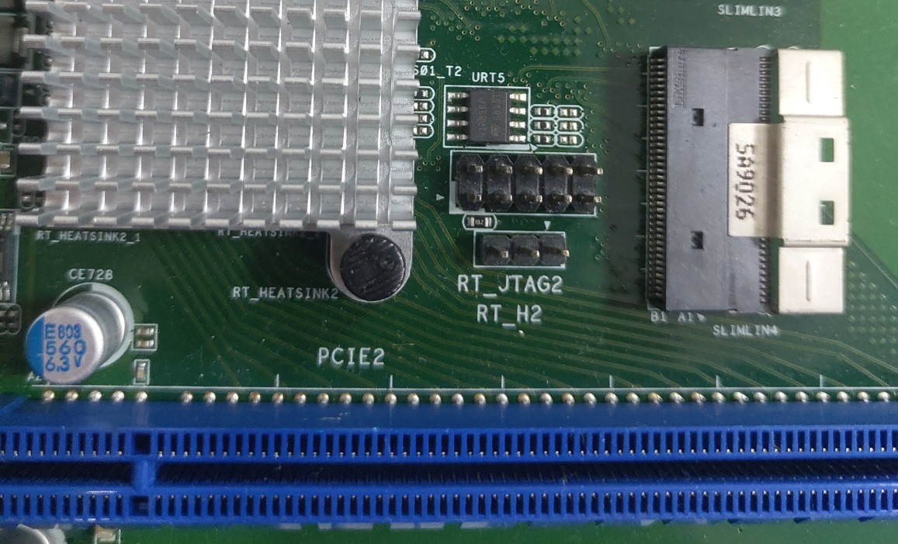
A-6 Program retimer2 FW: Connect fixture to RT_H2 header

Slide 9
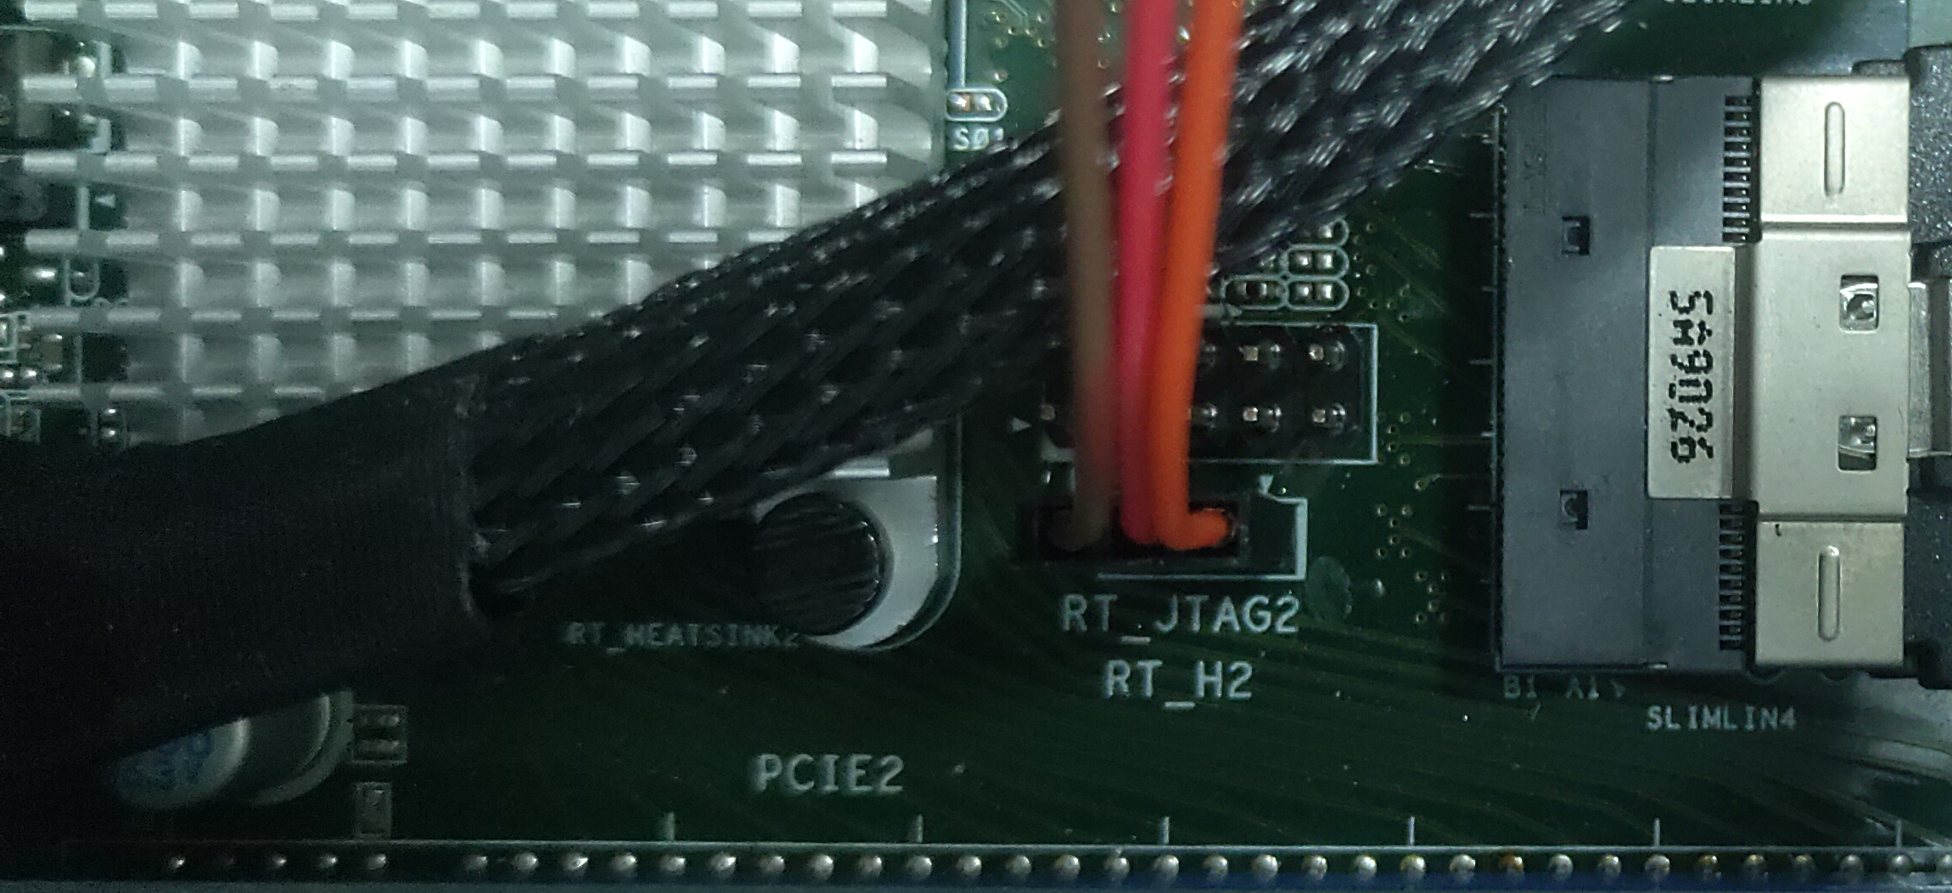
Orange cable to Pin 1

Slide 10
A-7 Execute retimer tool in client windows

Slide 11
A-8 Select EPROM->Program

Slide 12
A-9 Programming

Slide 13
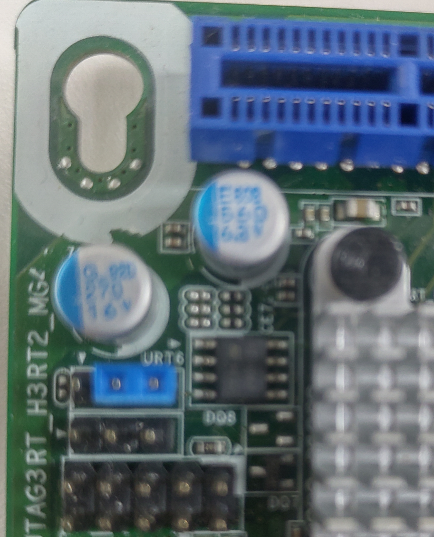
A-10 Program retimer3 FW: Connect fixture to RT_H3 header

Slide 14
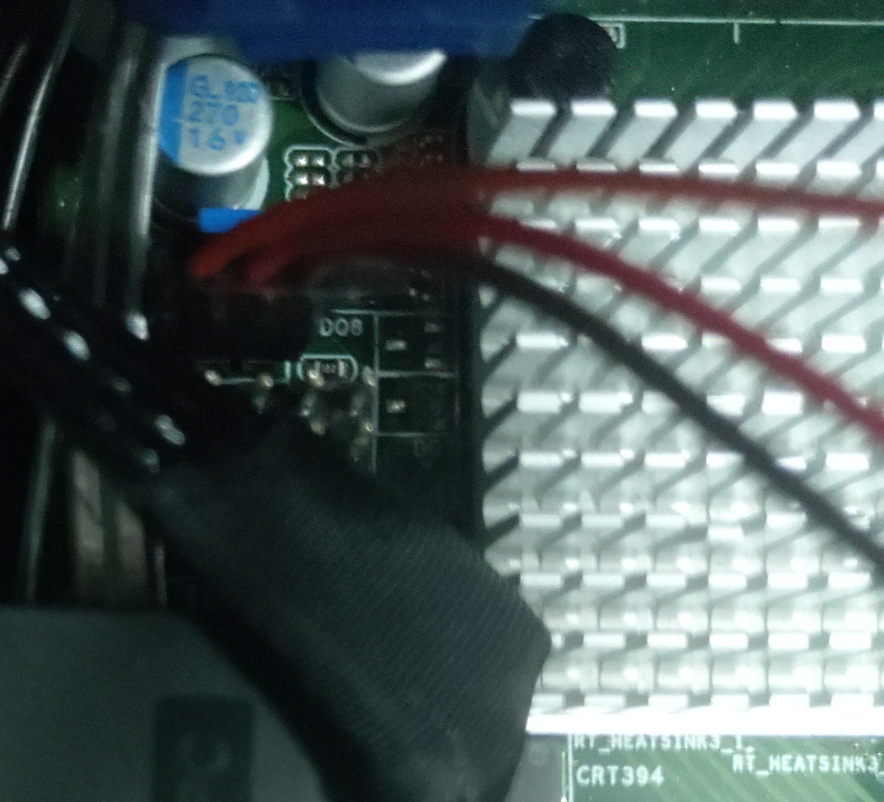
Orange cable to Pin 1

Slide 15
A-11 Execute retimer tool in client windows

Slide 16
A-12 Select EPROM->Program

Slide 17
A-13 Programming

Slide 18
A-14 Power off the system

Slide 19
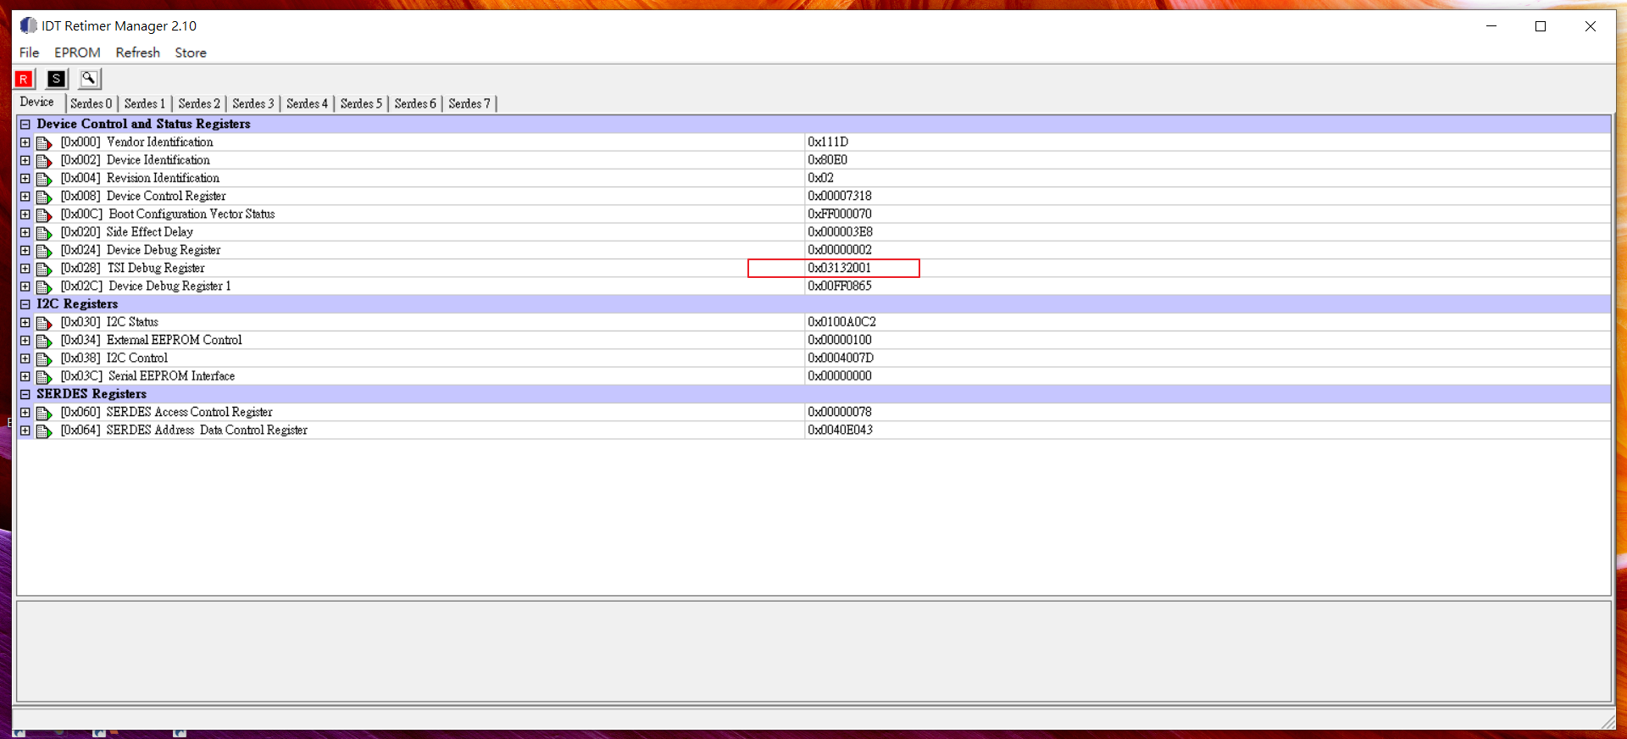
A-15 Power on and check the FW info.

Slide 20
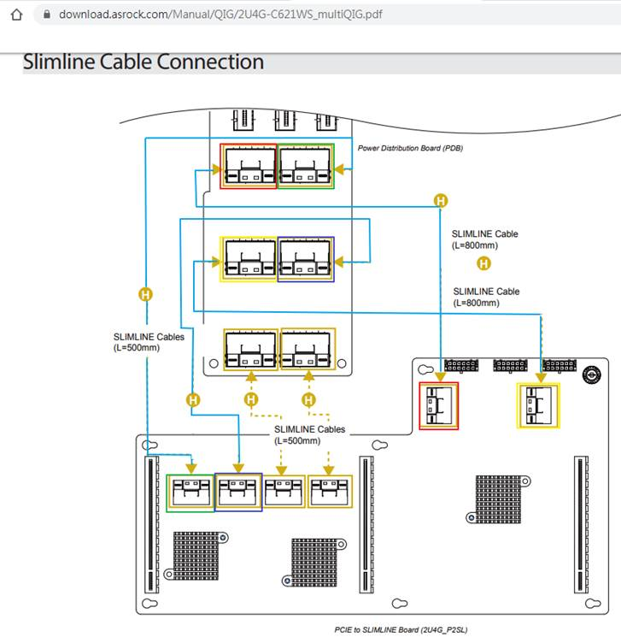
B. Slimline cable routing
Please refer picture to
re-connect slimline cable to perform better singal

